Slide 1
4 GPU comparative tests

Slide 2
Non-data parallel tests

Slide 3
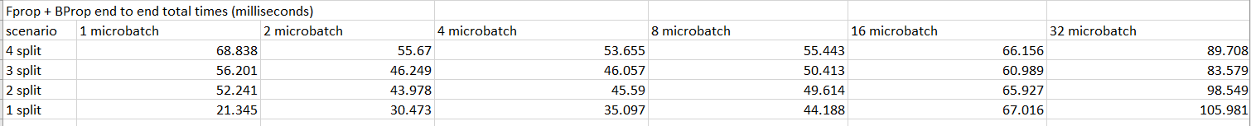
Fprop + Bprop end-to-end total times
In most cases, performance improves upto a point, then drops suddenly.

Slide 4
Remarks
When some amount of pipeline-parallelism is possible, we see that performance improves upto a point for same split configuration.
For sufficiently large micro-batch sizes the amount of parallelism is improved
This is also accompanied by negligible performance loss due to increased accumulated compute times.
Two factors- increased time due to micro-batch size, and increased parallelism must be correctly balanced for best performance

Slide 5
Fprop end-to-end times
A similar performance trend for Fprop times.

Slide 6
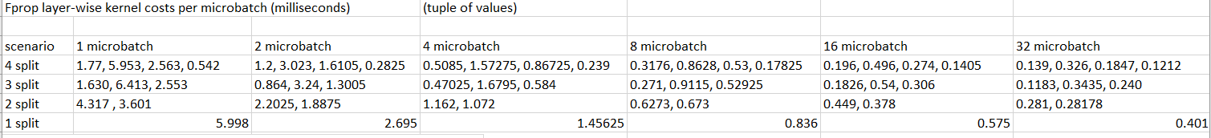
Fprop layer-wise compute costs per micro-batch
Lets focus on 3 examples to understand how these costs vary for different micro-batches (2 split and 3 split and 4 split)

Slide 7
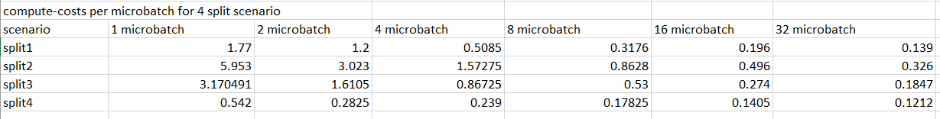
4 split scenario
Partitions are not evenly distributed

Slide 8
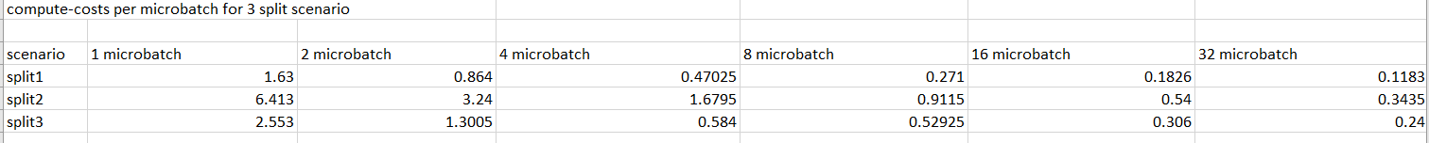
3 split scenario
Partitioning is unevenly distributed

Slide 9
2 split scenario
Almost evenly distributed when compared to prior two cases

Slide 10
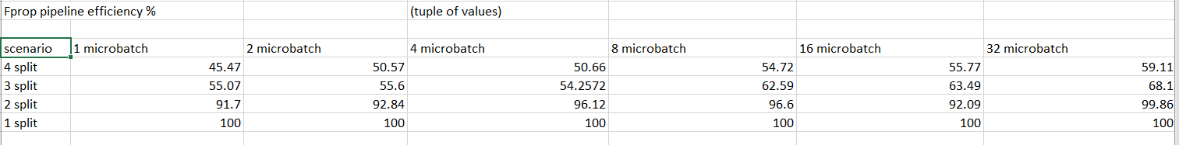
Fprop pipeline efficiencies
The poor partitioning of 4 split and 3 split also leads to a lower pipeline efficiency.

Slide 11
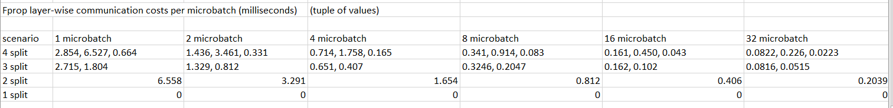
Fprop communication costs
Notice that communication costs, unlike communication costs do not flatten out for large micro-batches.

Slide 12
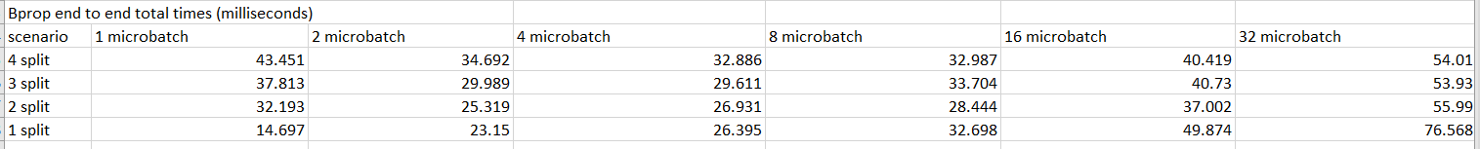
Bprop end-to-end times
Bprop also improves upto a point with
increasing micro-batches. After that, its
Between competing factors of saturating
compute times vs more pipeline parallelism

Slide 13
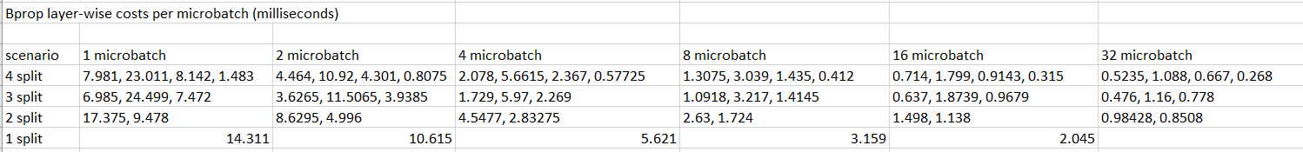
Bprop layer-wise computation costs
Lets compare 4 split, 3 split and 2 split scenarios

Slide 14
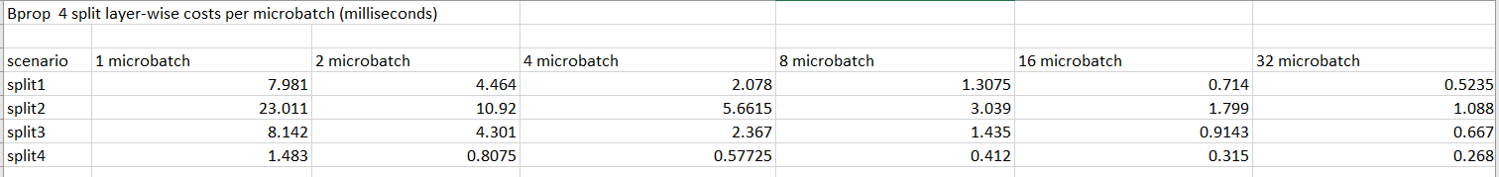
4 split
Observe that the distribution is almost the same as Fprop 4 split case.

Slide 15
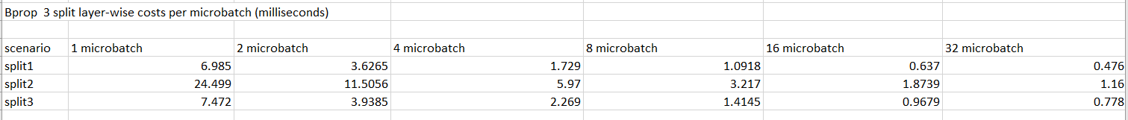
3 split

Slide 16
2 split

Slide 17
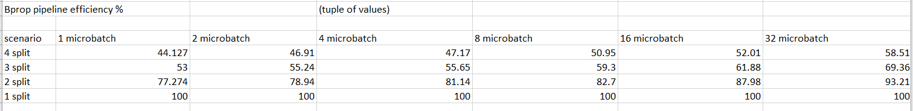
Bprop pipeline efficiency
Again, 2 split pipeline efficiency is better than 4 and 3 split.

Slide 18
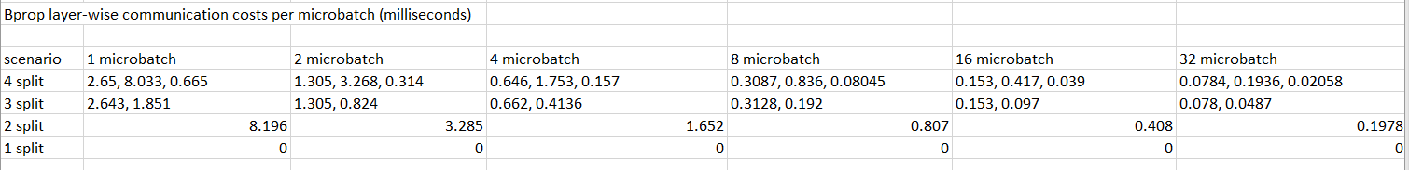
Bprop layer-wise communication costs
Here also, communication costs does not saturate/flatten with increasing micro-batches

Slide 19
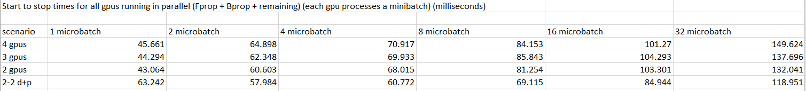
Data-parallel tests
However, each GPU processes a different minibatch, i.e, in 45.661 seconds (1 microbatch, 4 gpus), 4 minibatches are taken at a time, so throughput is greater.

Slide 20
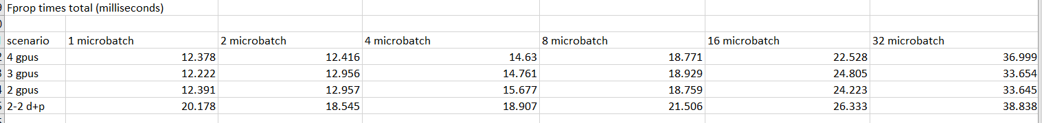
Fprop times (end-to-end)

Slide 21
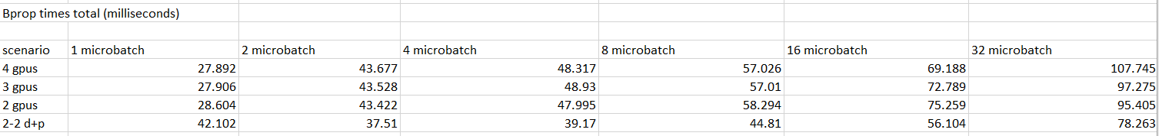
Bprop times (end-to-end)

Slide 22
Remarks
The pipeline efficiency of 3 and 4 split is quite less
For better performance, it is necessary to improve partitioning
LeNet5 is not suitable for testing multiple partitioning sequences, due to small number of layers
A better understanding of performance can be obtained after partitioning all splits such that all have similar pipeline efficiency

Slide 23
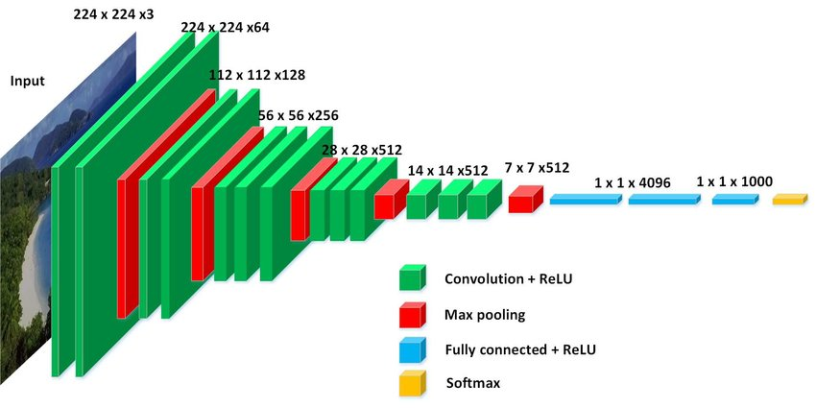
VGG-16 model
138 million parameters

Slide 24
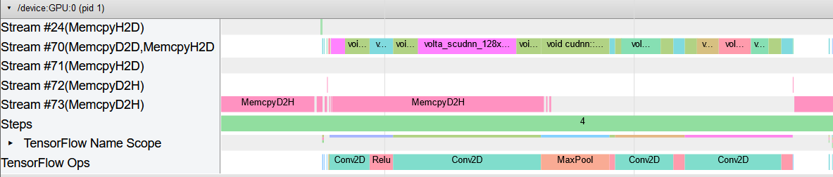
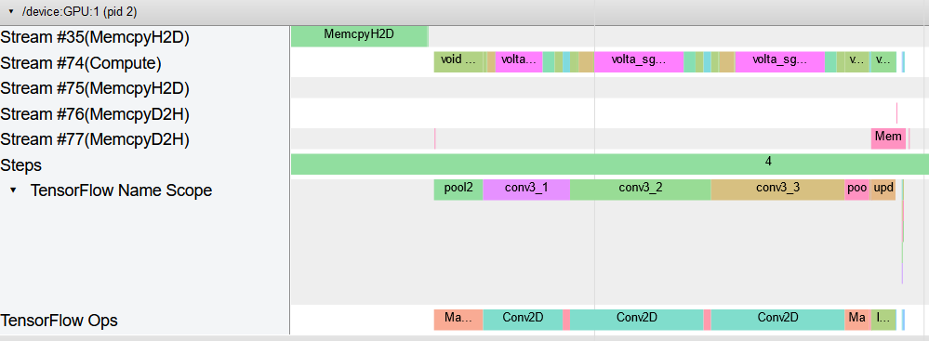

Slide 25
